Slide 1
Introduction to MATLAB
M M Manjurul Islam
July 25, 2025

Slide 2
Aim
To understand and manipulate introductory features and functions for programming in MATLAB.
Simulating a simple neuron model using the Leaky Integrate-and-Fire (LIF) model.

Slide 3


Why do I need to learn ‘it’?
What is Matlab?
Because the course leader said so…

Slide 4
What is MATLAB?
MATrix LABoratory program (MATLAB), a high-level programming language and environment, initially written for scientists and engineers (in industry and academia) with interactive access to numerical computation libraries, and use matrix based techniques to solve problems without having to write programs in traditional languages e.g. C and Fortran.
Now, MATLAB is a commercial (needs license) software package that operates as an interactive programming environment with graphical output, including creation of user interfaces. Used in Windows, UNIX, OSX, etc environments, and interfacing with C, C++, C#, Fortran, Java, Python, etc.
MATLAB is primarily for numerical computing, and assumes almost every data object to be an array (ie. a matrix). But MuPAD allows symbolic computing, and Simulink allows graphical multi-domain simulation and model-based design for dynamic and embedded systems.
https://uk.mathworks.com/
https://en.wikipedia.org/wiki/MATLAB

Slide 5
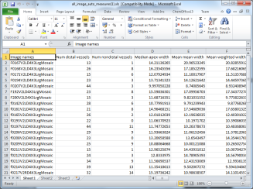

What is Matlab?
Matlab is both a program and a programming language ...
… it has lots of tools you can just use to analyse data and images. But you can also write code to extend it to do any analysis you like (although unlike a ‘pure’ language, it will only work if the Matlab program is installed on the computer).
Excel
Photoshop
+
+
Using other people’s code
+
Writing your own code
=
A really powerful tool for imaging research!

Slide 6

What is a computer program?
In medical imaging…
DATA
Image(s)
PROGRAM
RESULT
Lab results
Hopefully clinically useful!
Patient data
Do something clever…

Slide 7
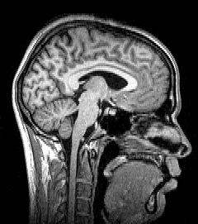
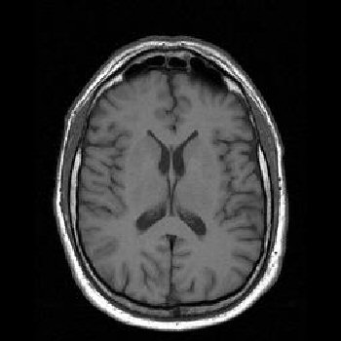
What is a computer program?
In medical imaging…
DATA
PROGRAM
RESULT
Predict whether the patient has Alzheimer’s Disease
MR images of the brain
Measure volume of grey/white matter…

Slide 8

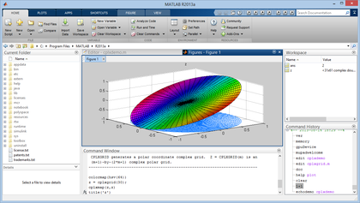
Why?
Built-in operations to handle arrays/matrices. E.g. 2 arrays together needs only 1 command cf. a for or while loop (as in C)
Easy to prototype! Much lesser lines of codes!
Graphical output optimized for interaction – very user friendly
Additional toolboxes could be included e.g. Statistics Toolbox for more specialized statistical manipulation of data (Anova, data fitting, etc)

Slide 9
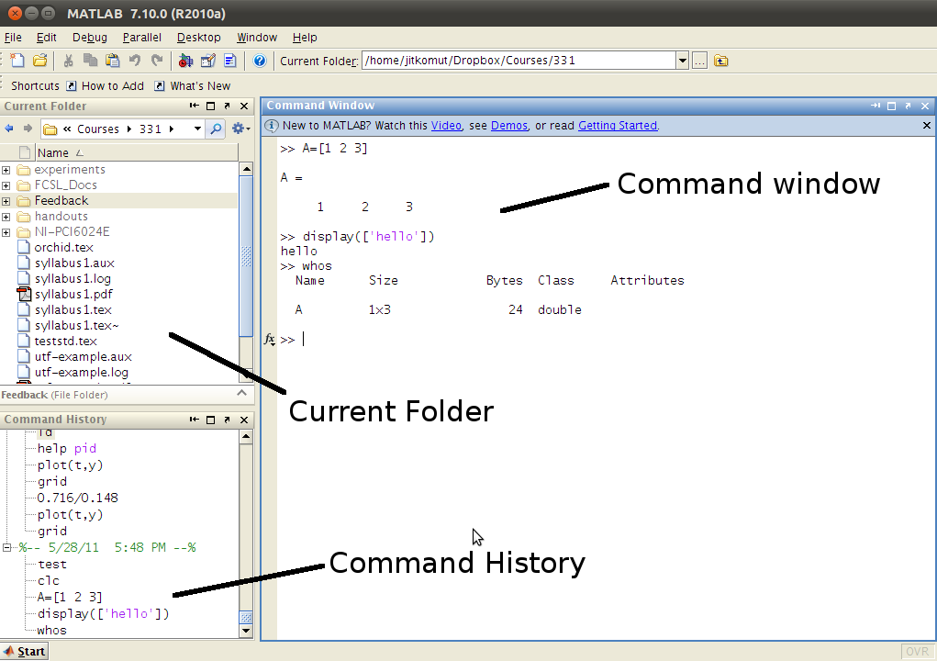
MATLAB environment

Slide 10
Advantages
User-Friendly Interface: Simplifies complex computations and tasks.
Extensive Mathematical Functions: Supports a wide range of engineering and scientific applications.
Robust Visualization Capabilities: Ideal for data analysis and presentation.
Versatile Usage: Perfect for developing algorithms, analyzing data, and simulating complex systems.
Preferred by Engineers, Scientists, Researchers, and Educators: A reliable tool for academic and professional use.

Slide 11

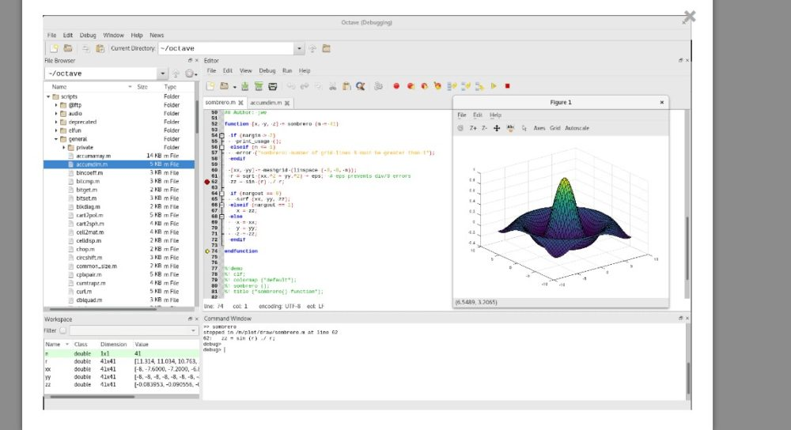
Disadvantages or Limitations
Uses lots of memory and hard to use with slow computers
Real-time computing an issue
Expensive license
A free alternative, compatible with MATLAB – Octave
https://www.gnu.org/software/octave/

Slide 12
Introduction to MATLAB programming
In MATLAB, the scripts are written in *.m or .mlx (cf. e.g. *.c in C programming)
These are scripts, not programs, and read by an interpreter (unlike in e.g. C where they are compiled). But documentation in MATLAB refers to scripts as programs. So we’ll follow that.
To create a script, click File, then New, then M-file. A new window will appear called the Editor. To create a new script, simply type the sequence of statements and click Run (or F5).
Save the file using File → Save. Make sure the extension is in *.m format. Rules for filenames are the same as for variable (must start with a letter, and after that there can be letters, digits or underscore, etc). Once saved and closed, the file can be reopened by clicking File → Open and then select the name of the file.

Slide 13
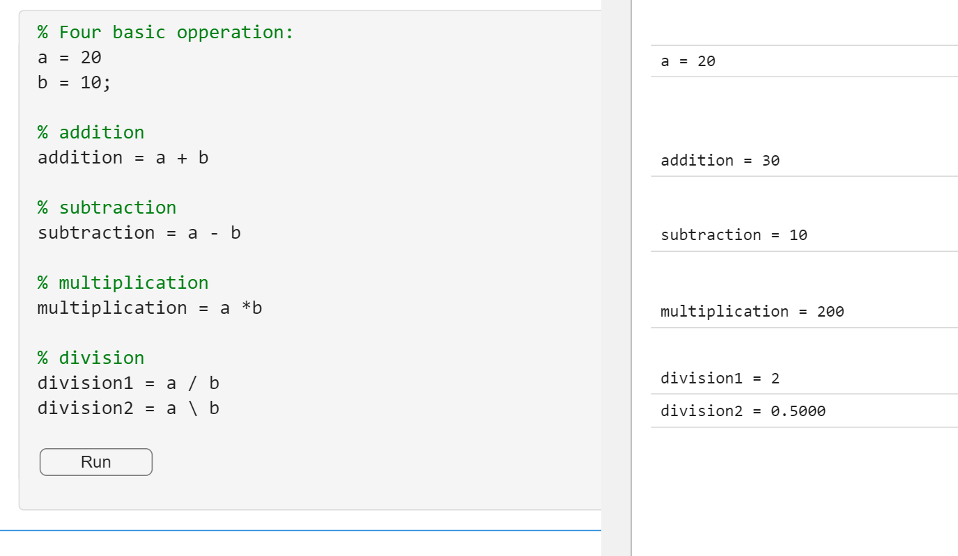
Code Snippet

Slide 14
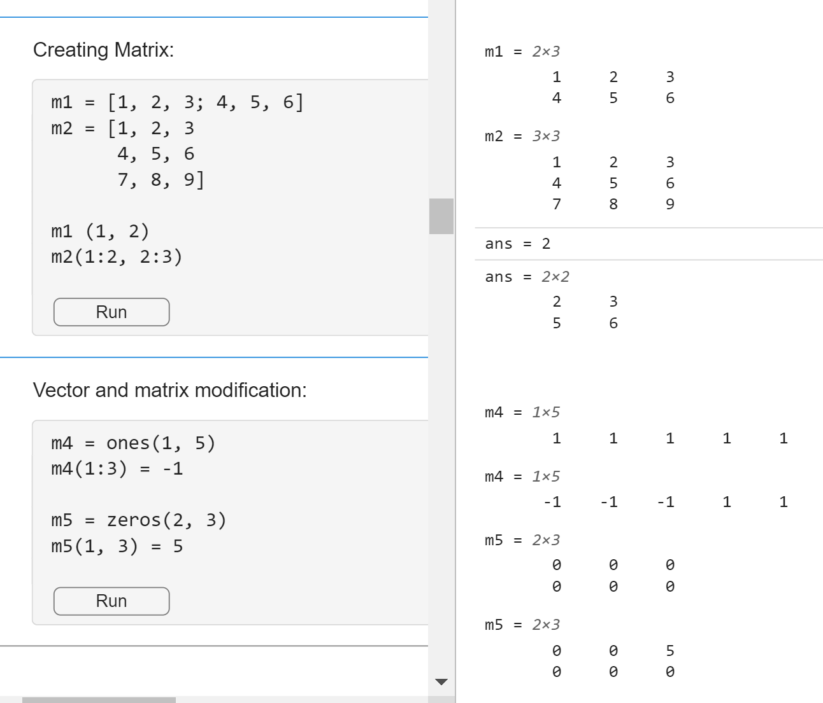
Code Snippet

Slide 15

Download the lab tutorial file
https://tinyurl.com/basic-matlab

Slide 16
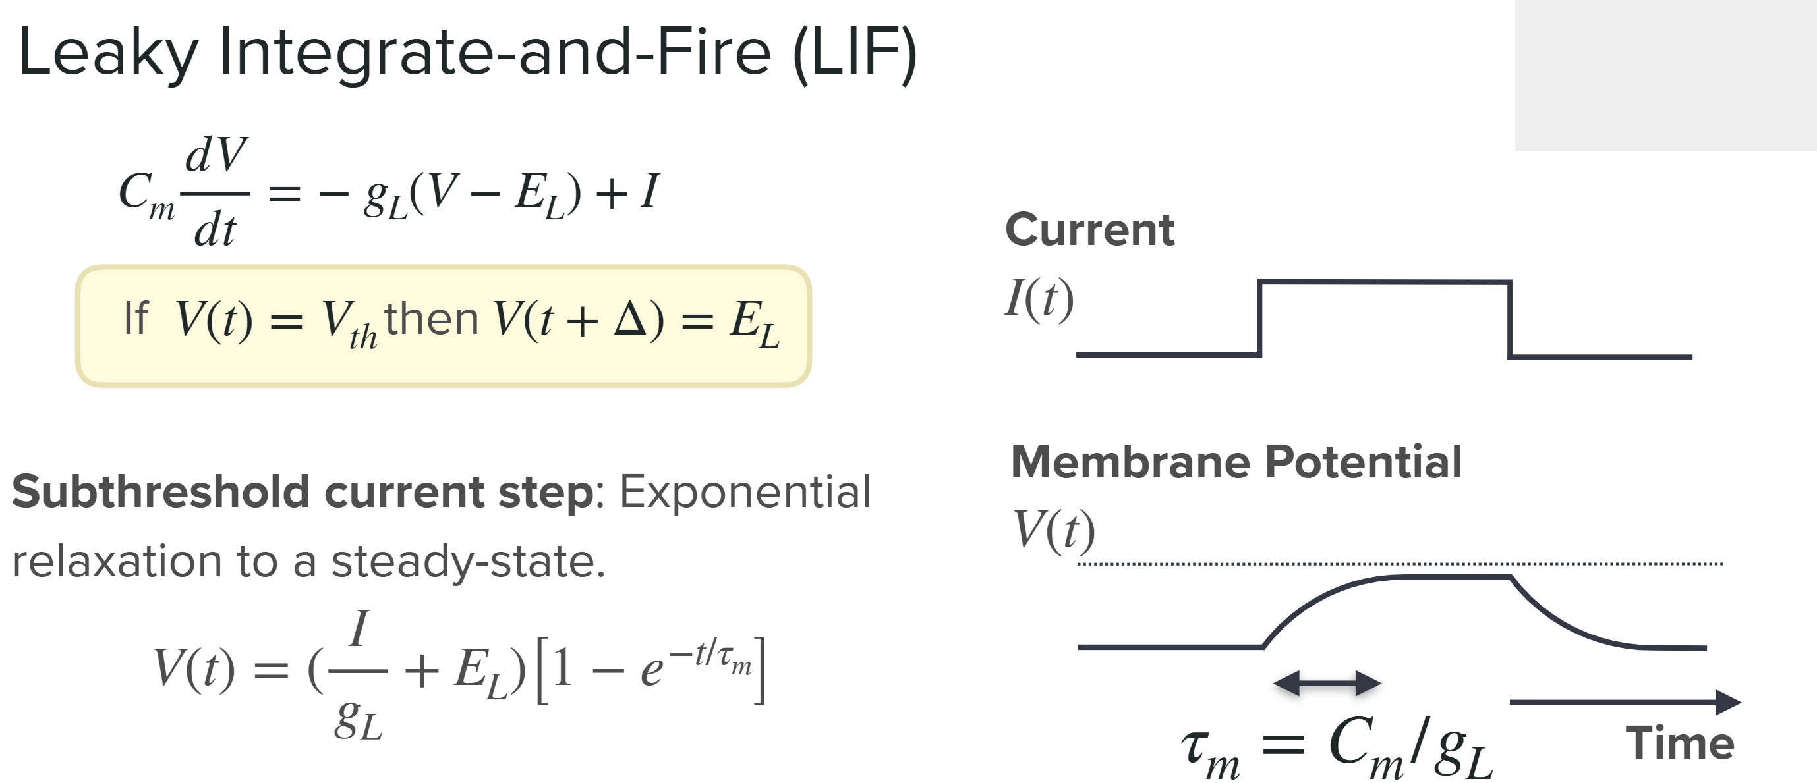
https://compneuro.neuromatch.io/

Slide 17
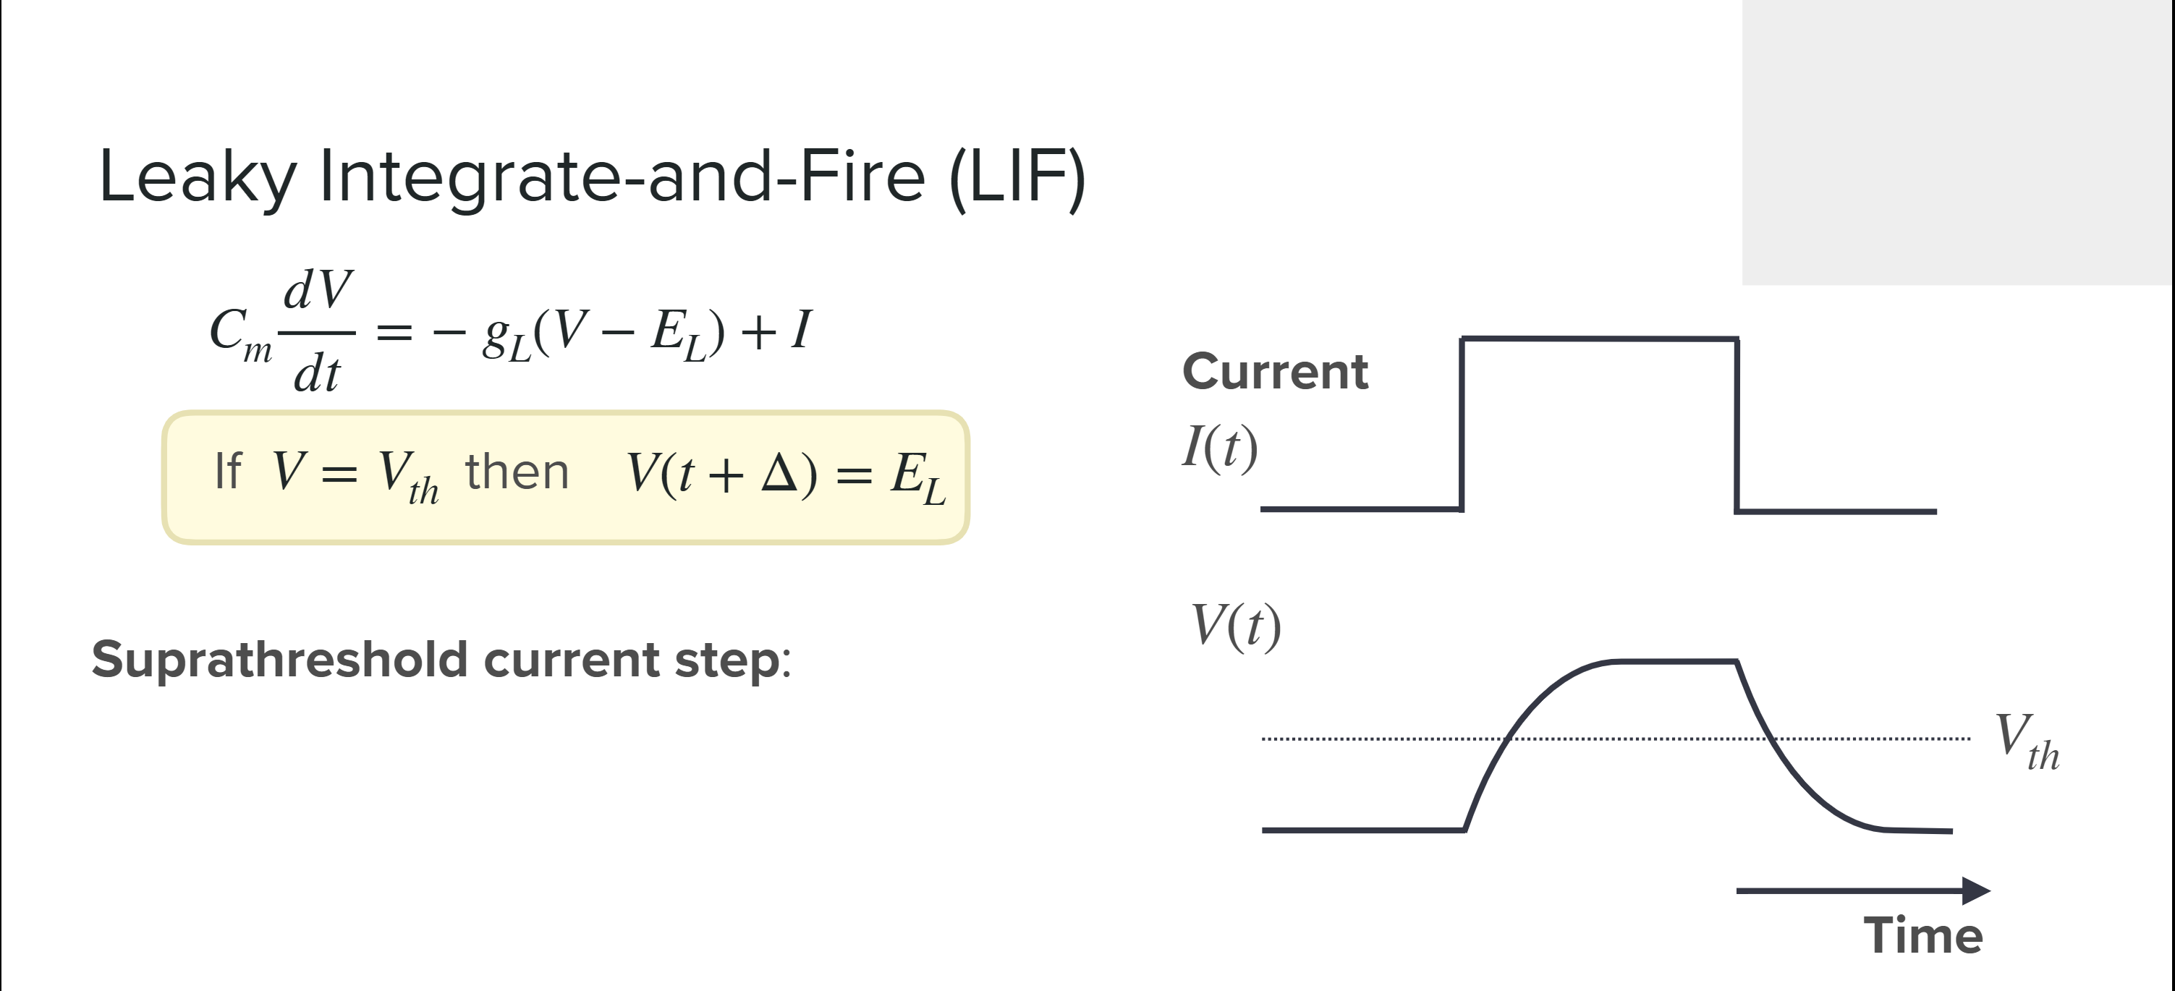
https://compneuro.neuromatch.io/

Slide 18
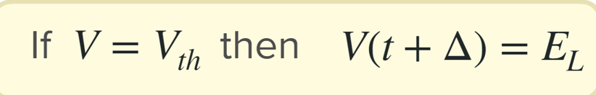
Exercise (Write a MATLAB code for simulation of LIF model)
Hint:
tau = 0.010; % Membrane time constant (tau) in seconds
E_L = -0.070; % Leak potential (also known as resting potential) in volts
Vth = -0.050; % Threshold potential in volts (the potential at which a spike is generated)
Vreset = -0.080; % Reset potential in volts (the potential after a spike)
Cm = 100e-12; % Total membrane capacitance in farads
G_L = Cm / tau; % Total membrane conductance (leak conductance) in siemens
Iapp = 210e-12; % Value of applied current steps in amperes
V(i) = V(i-1) + dt * (I(i) + G_L * (E_L - V(i-1))) / Cm; % Update membrane potential using Forward Euler method

Slide 19
Thank you!

